Slide 1
SEVEN SEGMENT DISPLAY AND KEYBOARD INTERFACING

Slide 2
INTRODUCTION
Most of the microprocessor controlled instruments and machines need to display letters of the alphabet and numbers to give directions or data values to users.
This can be displayed using CRT, LED or LCD displays.
CRT displays are used when a large amount of data is to be displayed.
In systems where only a small amount of data is to be displayed, simple LED and LCD displays are used.

Slide 3
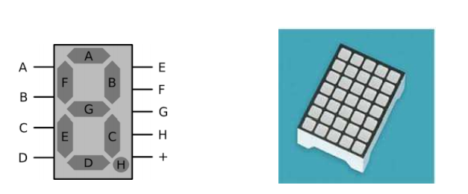
LED DISPLAYS
LED Displays are available in two very common formats.
a. 7 segment displays
b. 5 by 7 dot-matrix displays
The 7-segment type is the least expensive, most commonly used and easiest to interface.

Slide 4
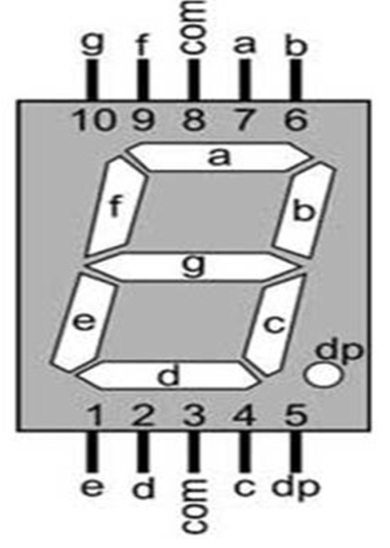
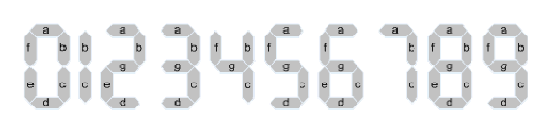
7 SEGMENT DISPLAY
7 segment displays are generally used as numerical indicators and consists of a number of LEDs arranged in seven segments.
Any number between 0 to 9 can be indicated by lighting the appropriate segments.
The seven segments are labeled a to g and dot is labeled as dp.

Slide 5
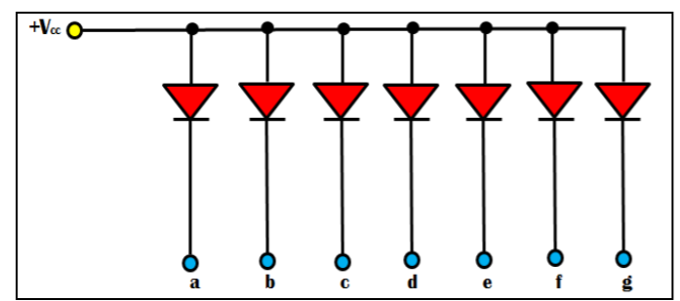
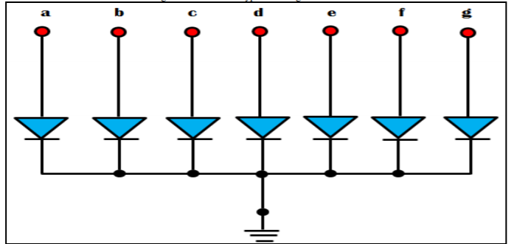
Types of 7-segment displays
These 7 segment displays are of two types:
Common Anode
Common Cathode
Anode
Anode
cathode
cathode
COMMON ANODE
COMMON CATHODE

Slide 6
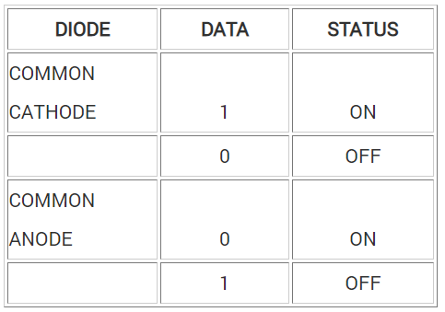
Basically LED have Anode & Cathode. In order to simplify connecting, anodes and cathodes of all diodes are connected to the common pin.
In Common Anode display, anodes of the all LEDs are connected to Vcc, cathodes are connected to microprocessor port pins via 8255.
In Common Cathode display, cathodes of the all LEDs are connected to Gnd, anodes are connected to microprocessor port pins via 8255.

Slide 7
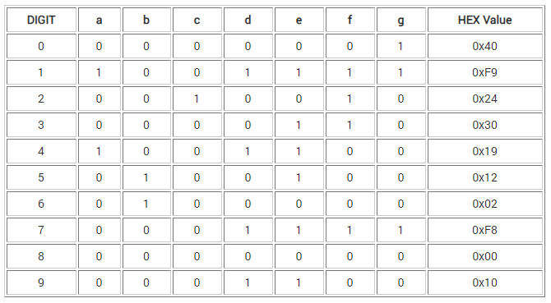
COMMON ANODE SEGMENT CODE

Slide 8
Interfacing 7-segment display with 8086
Problem: Interface an 8255 with 8086 at 80H as an I/O address of port A. Interface five 7 segment displays with 8255. Write a sequence of instructions to display 1, 2, 3, 4 and 5 over five displays continuously as per their positions starting with 1 at the least significant position

Slide 9
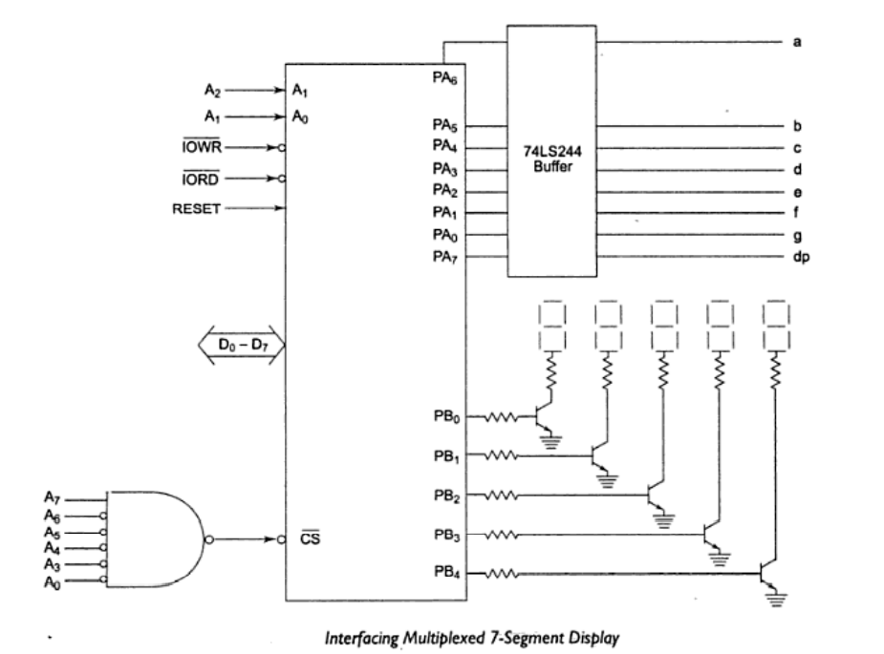
Interfacing 7-segment display with 8086 via 8255

Slide 10
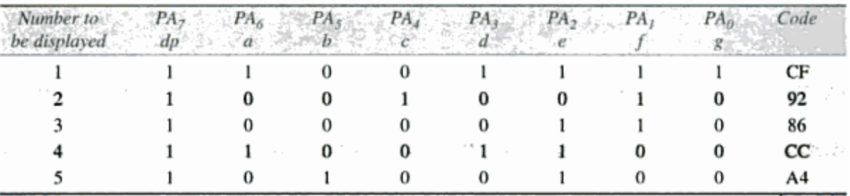
Interfacing 7-segment display with 8086 via 8255
In this scheme, I/O port A is multiplexed to carry data to all the 7-segment displays. The port B selects one of the display at a time.
The display used are common anode type.
All these codes, decided above, are stored in a look up table starting at 2000:0001

Slide 11
ALP
AGAIN:
MOV CL,05H ;Count for displays
MOV BX,2000H ;Initialize data segment
MOV DS,BX ;for look up table
MOV CH,01H ;1st number to be displayed
MOV AL,80H ;Load control word in the
OUT 86H,AL ;CWR
MOV DL,01H ;Enable code for Least significant 7-seg display

Slide 12
NXTDGT:
MOV BX,0000H;Set pointer to look up table
MOV AL,CH ;First no to display
;Store number to be displayed in AL
XLAT ;Find code from look up table
OUT 80H,AL ;Display the code
MOV AL,DL ;Enable the display
OUT 82H,AL;
ROL DL ;Go for selecting next display
INC CH ;Next number to display
DEC CL
JNZ NXTDGT ;Go for next digit display
JMP AGAIN

Slide 13
Interfacing Keyboard
Keyboard Types:
When you press a key on your computer, you are activating a switch. There are many different ways of making these switches.
Mechanical Key Switches
Membrane Key Switches
Capacitive Key Switches
Hall Effect Key Switches

Slide 14
Interfacing Keyboard
In most keyboards, the key switches are connected in a matrix of rows and columns.
We use simple mechanical switches but the principle is same for other types of switches
Getting a meaningful data from a keyboard requires three major tasks.
1. Detect a key press.
2. Debounce the key press
3. Encode the key press
The three tasks can be done with hardware, software, or a combination of two depending on application.

Slide 15
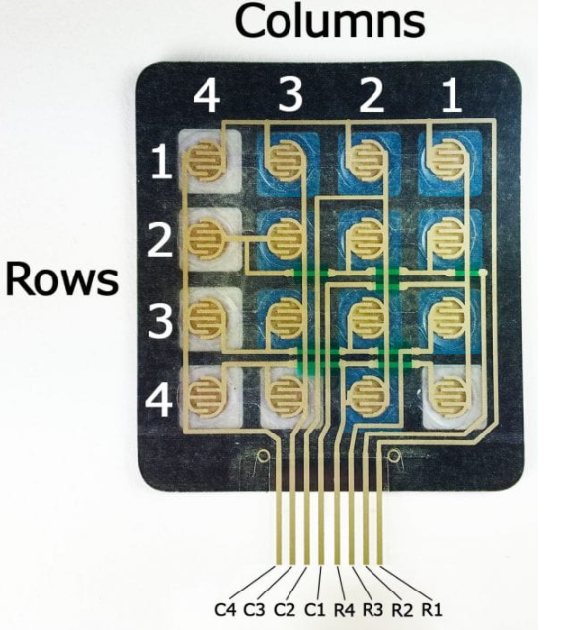
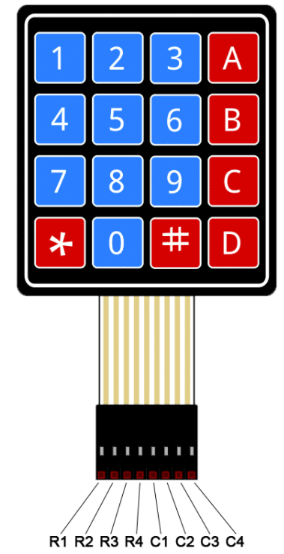
KEYBOARD CIRCUIT CONNECTION
Each switch in a row is connected to other switches in the row by a conductive trace underneath the pad.
Each switch in a column is connected the same way
Each row and column is brought out to a single pin, for a total of 8 pins on a 4X4 keypad.
Pressing a button closes the switch between a column and a row urrent tetween a column pin and a row pin.

Slide 16

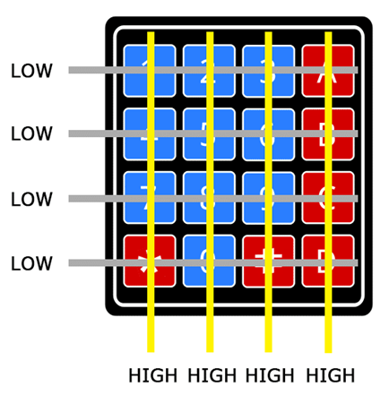
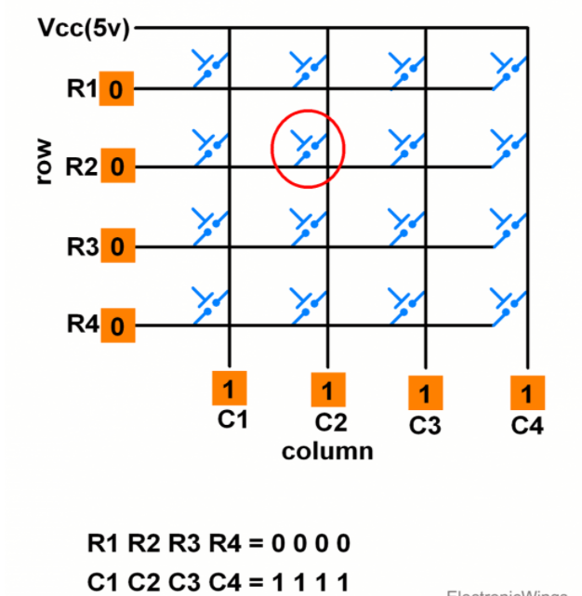

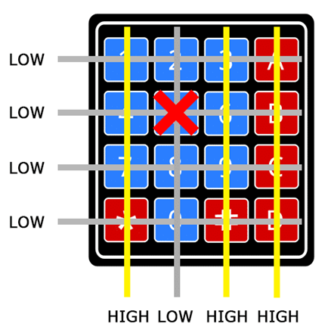
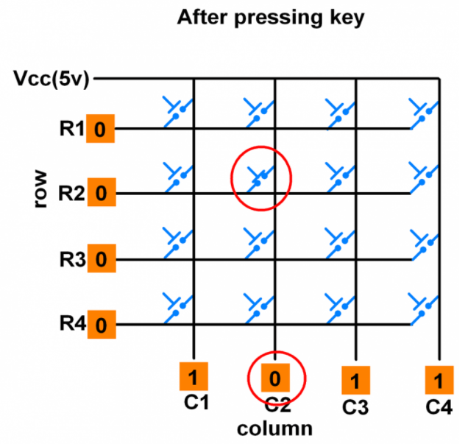
How it works?.
First, when no buttons are pressed, all of the column pins are held HIGH, and all of the row pins are held LOW.
When a button is pressed, the column pin is pulled LOW since the current from the HIGH column flows to the LOW row pin:

Slide 17

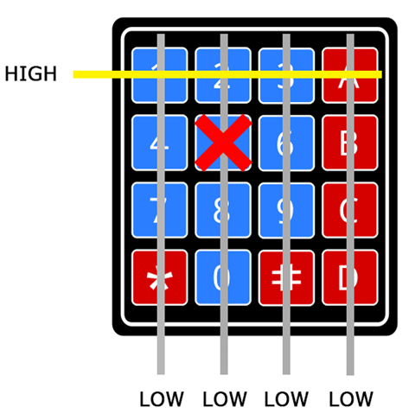

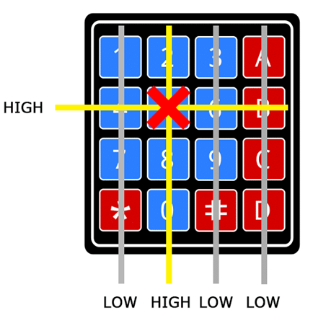
now knows which column the button is in, so now it just needs to find the row the button is in. It does this by switching each one of the row pins HIGH, and at the same time reading all of the column pins to detect which column pin returns to HIGH.
When the column pin goes HIGH again, it has found the row pin that is connected to the button

Slide 18
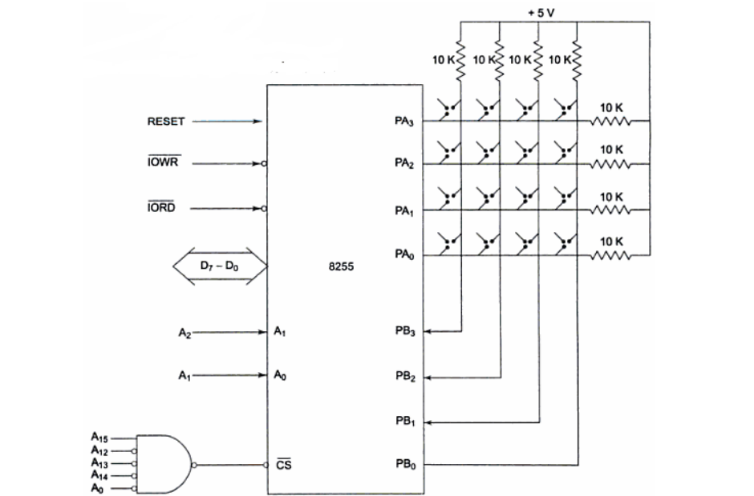
Interfacing Keyboard via 8255

Slide 19
Port A is used as output port for selecting a rows of key while port B is used as an input port for sensing a closed key.
Thus keyboard lines are selected one by one through port A and the port B lines are polled continuously till a key closure is sensed.
Then routine DEBOUNCE is called for debouncing.
The key code is decided depending upon the selected row and a low sensed column.
The higher order lines of port A and port B are left unused.

Slide 20
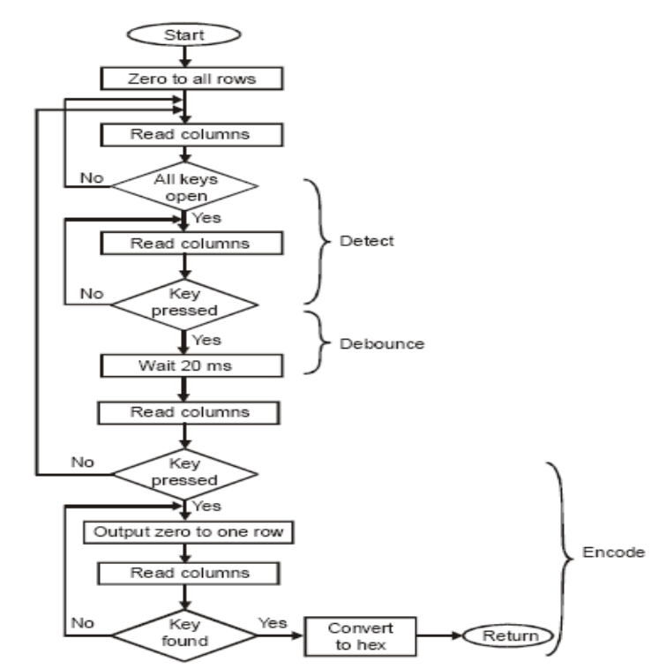
FLOWCHART

